Slide 1

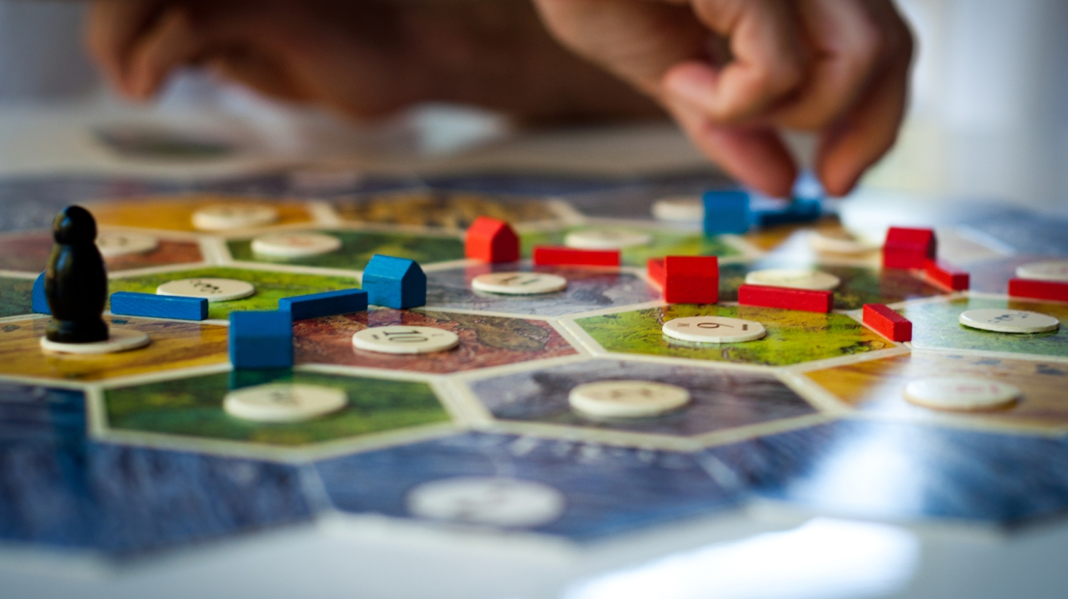
Notes:
Have you ever tried learning a new board game with your friends and felt utterly confused by the rules after trying to understand them for an hour, then played the game having to refer back to the rulebook every 5 minutes and still unsure if you’re playing it right?
Now imagine the time, money and work it goes into designing these games. Every detail and rule needs to be correct as it is expensive and sometimes impossible to patch or fix a physical board game after release, the way we can easily patch and fix software. This means we need to dedicate thousands of man hours to test and balance knowing the game is absolutely correct before releasing to customers.
If only we had a way to forgo this manual and tedious process?

Slide 2
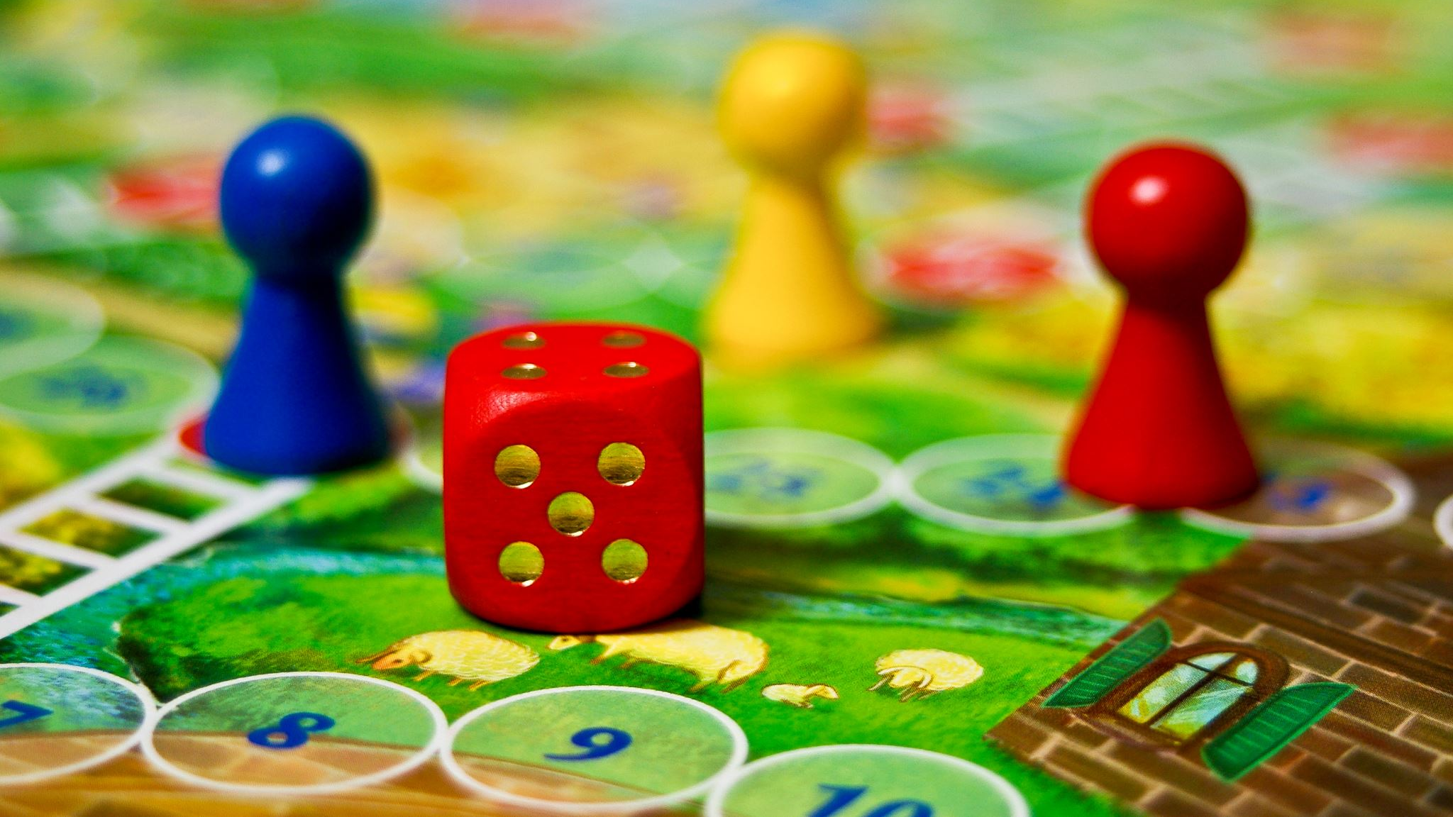
An AI-based Approach to Designing Board Games
Team #6, Board Gamers Ilao Michael, ilaom Bedi Hargun, bedih Dang Jeffrey, dangj12 Ada Jonah, karaatan Mai Tianzheng, mait6
SUPERVISORS
DR. SEBASTIEN MOSSER
DR. VLADIMIR REINHARZ
Notes:
Good afternoon, my name is ____ with “team members” and our supervisors Dr Mosser and Dr. Reinharz, we’re going to discuss how we can leverage software and AI to help the designers of “An Age Contrived”, a complex strategy game to help design their game

Slide 3
Can we design a system to help game designers to balance their game in a more efficient way?
Current Human Approach
AI-Based Approach
Tedious
Each game takes 3+ hours
Expensive
Even paying minimum wage is expensive
Possible Biases
Will contain strategic thinking of test participants
Analyzing Data
Manually record player actions and compile them in a straightforward way
Accelerated
Games complete much faster (thousands can finish in a few hour)
One-time cost
After a certain level of complexity, requires stronger computing power
Bias Free
Reinforcement learning method based only game rules
Data Visualizer
Interactive way to visualize hundreds of simulations at once
Notes:
Can we design a system to help game designers to balance their game in a cost and efficient way?
To tackle this kind of project where we need to design a system that replaces the thousands of human hours; That are tedious, expensive may contain bias and in the end manually record all their actions and games
With an AI based Approach we can run thousands of simulations with no human interaction, additional costs of paying play testers aren’t needed,
A bias free AI will help explore many different game paths even uncommon ones, a typical human would never think of and learn patterns that lead to winning.
Instead of manually recording each action we can have software record these instead and compile them in an interactive way.

Slide 4
The 3 Pillars
AI
Game Engine
Data Visualizer
Notes:
From this AI Based Approach – our system has these 3 pillars The AI, The Game Engine and the Data Visualizer.
Each has their own goal and challenges that we need to not only solve, but also plan for a fallback to mitigate risk in case of failure.
MENTION TO THE AUDIENCE, RESULTS WILL BE REVELAED AFTER DISCUSSING THE PILLARS

Slide 5
Pillar 1 - AI
Complex strategy games have infinitely many paths to victory
Simulate and explore the game space & different strategies
Leverage AI to explore as much game space as possible and learn winning strategies
Reinforcement Learning
Doesn’t require previous data (Challenge – To output data)
Input - Game rules to be explored
Notes:
As you can imagine these complex strategy games have infinitely many possible interactions and routes to victory, similar to games like chess.
We need a way to try to simulate as many games as possible as well as explore different patterns that lead to winning.
This is where we can leverage AI , we don’t need the smartest AI for this project, we need to try and explore as much as the game rules as possible while also learning patterns that were common in winning scenarios.
This is where we can use “reinforcement” learning to find these hidden patterns without the need for direct human intervention to label these stragetiges.

Slide 6
Challenges & Risk Management
There were many AI libraries designed for specific tasks
Proficient in different aspects
Libraries had written documentation explaining the same features in different ways
Prevent total failure if one library was not sufficient
Risk management: To identify a library that provided:
Modularity and Portability
Multi-agent learning
Notes:
-There were many AI libraries to choose from, with different strengths and weaknesses . We needed to find the perfect trade-off that suited our project.
-Library documentation was difficult to understand as terms were not general across libraries and would require direct involvement in testing to find these qualtieis
-To manage risk at this pillar, we explored multiple libraries in parallel trying to develop a simple tic-tac-toe, so that if one library was not sufficient we didn’t fail and have to restart at square one. We looked at libraries that are highly modular and portable and that provided multi-agent learning where multiple AI agents can play and learn at the same time

Slide 7
Pillar 2 – Game Engine
Reinforcement Learning method takes the game rules as an input
Game Engine is where all the business logic (game rules) are written
The complexity varies vastly between game
Tic-Tac-Toe: Well known game with only couple rules vs.
An Age Contrived: Brand new game with 40-page game rulebook

Slide 8
Challenges & Risk Management
Risk management: The game Age Contrived had many rules and likelihood of implementing every rule was low
Used design patterns and modular architecture to incrementally implement features
Removing some non-essential features to save AI training time
Notes:
We first tried on a small input/game (Tic-Tac-Toe) to validate our design patterns and architecture and built the confidence to start working on the more complex game AAC to help our client.
We did not try to code all the game rules and integrated it at once, but rather took an incremental approach and kept integrating with AI, training the AI, generating the data and validating our progress before moving on the new features
Command design pattern, extensible architecture

Slide 9
Architecture Pattern
Actions
AI
Game Engine
Completed Feedback Loop
Game State
Notes:
This is the result of the first two pillars

Slide 10
Value Provided: Generating Data
When the first two pillars started to mature, we started to generate a lot of useful information
First essential goal was completed
In Parallel, we have started Building tools to analyzing the data generated to provide further value to the client

Slide 11
Pillar 3 - Data Visualizer
With large sets of data, it is very difficult to make logical sense of it
A data visualizer allows us to parse large data sets and organize it
Organized data is easier to analyze
Our aim was to only have a handful of graphs that tell us what's going on
Allows for certain patterns to be identified in the paths
Achieve our goal of providing a useful tool to analyze the data through fine-tuning

Slide 12
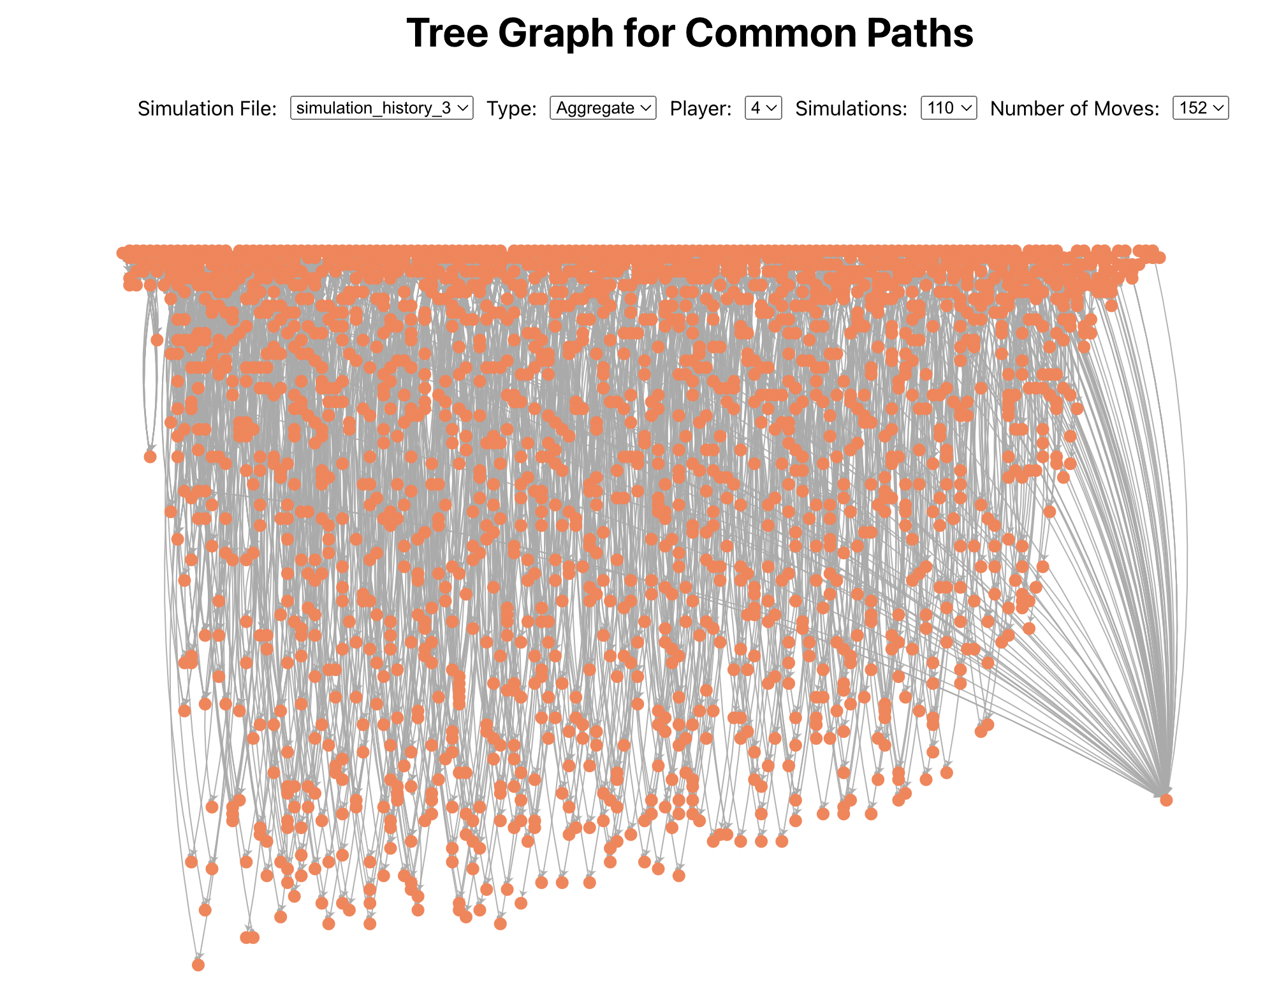

Slide 13
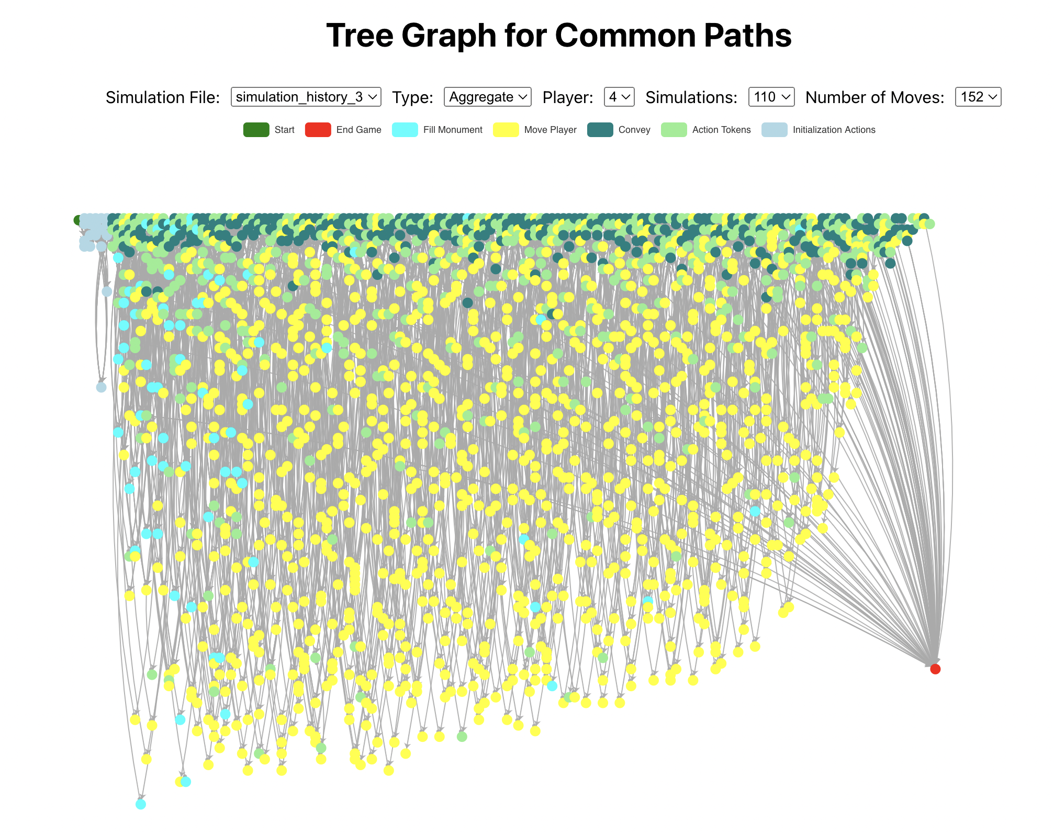

Slide 14
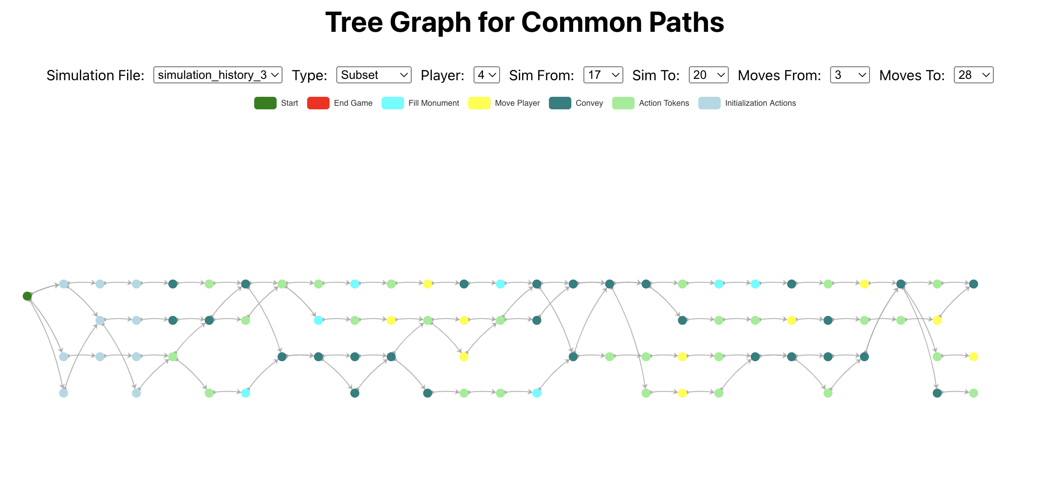

Slide 15
Value Provided: Tool for Analyzing
Allow the game designers to parse through the generated files easily
Make sense of the data generated
Compare different datasets to see how changes have an effect

Slide 16
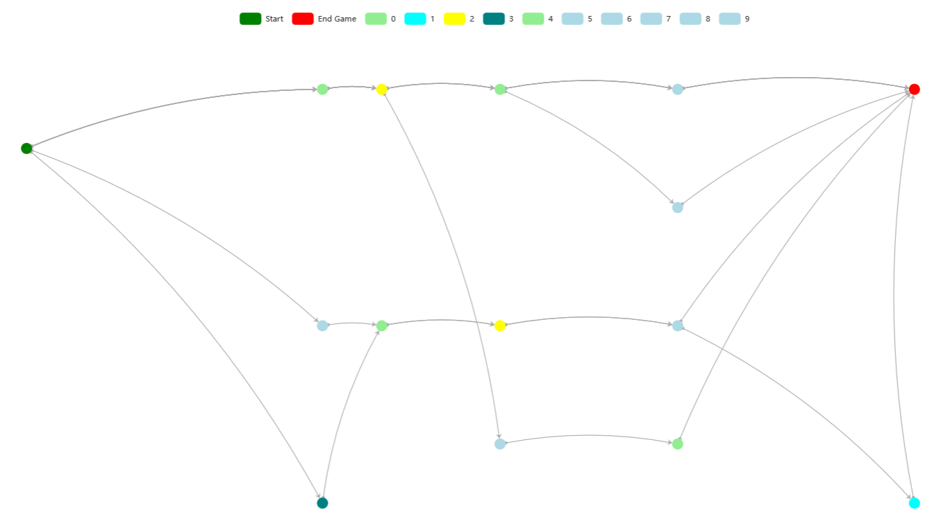
Verification & Validation Demo
Action Mapping
0
1
2
3
4
5
6
7
8
Notes:
This diagram, shows what each data point maps to onto a tictac board

Slide 17
Improvements
Complete the full game engine of An Age Contrived
Train the AI more and find ways to make it faster in training (ie. Parallelization)
Automatic interfacing between the game engine and the visualizer
Add more features to the data visualizer based on users' feedback
Notes:
1. Complete the full game engine of an age contrived
After that
2. make more effort on the ai algorithm and train it more efficiently to speed up the training process.
an example idea can be parallelization which we train multiple data concurrently.
Besides from this
3. automate the connection between the game engine and the visualizer. For now, we need to manually move the log file to the visualizer which is not an efficient way.
A feasible solution can be
Build a backend database or write a script to automatically pass the game engine data to the visualize
For the last improvement
4. add more features to the data visualizer based on user's feedback.
A perfect data visualizer can communicate complex information in a clear and concise manner.

Slide 18
Conclusion
Framework is extremely important to board game designers who can save hundred thousands of dollars and human resources to balance their game
The 3 pillars of our framework brought their own challenges, and we were able to resolve those challenges in order to meet our goals
Our framework functional & provides value, just a matter of putting more resources and training due to the scale of the game
Notes:
Value provided is the tools we built to analyze thousands of simulations and the simulator itself
Conclusion: A good framework can significantly help board game designers save a large amount of money and human resource while balancing the game. Our Ai framework helps the game designers identify and resolve unbalanced components before releasing the game to the market. The value of our framework is it analyzes thousands of simulations and the simulator itself.
The 3 pillars of our framework have their own challenges but we overcome these challenges and achieve our goals in the end.
Overall, our framework that we developed for the age-contrived and tic tac toe functionally works well, but it needs more resources and training to handle the large scale of the game. For now, the framework has been effective support the game to date, but as the game may continue to grow, more resource will be required to ensure it remains effective.

Slide 19

Thank You & Any Questions

